Slide 1
Unit-6 Application Layer Protocols and Services

Slide 2
Contents
Domain Name System (DNS)
Remote Logging (TELNET)
Electronic Mail (e-mail)
File Transfer Protocol (FTP)
WWW
HTTP
Network Management (SNMP)
Cryptography
Network Security
Internet Security- IPSec, VPN, Firewalls

Slide 3
Domain Name System (DNS)
There are several applications in the application layer of the Internet model that follow the client/server paradigm. The client/server programs can be divided into two categories:
Programs that can be directly used by the user, such as e-mail.
Programs that support other application programs. The Domain Name System (DNS) is a supporting program that is used by other programs such as e-mail.

Slide 4
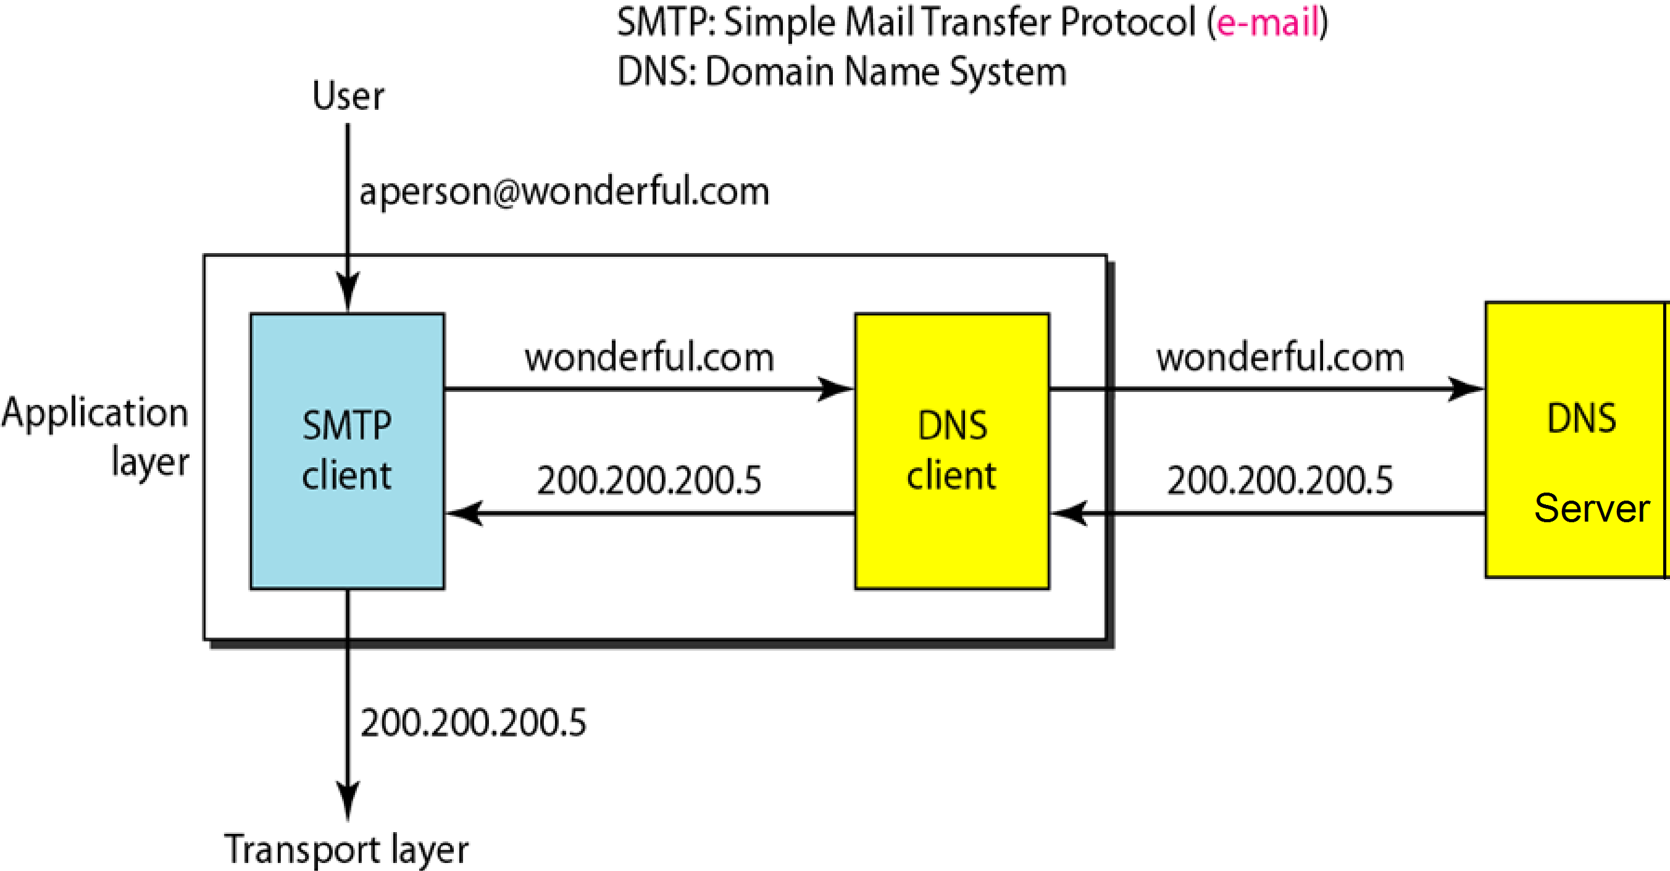
To identify an entity, TCP/IP protocols use the IP address, which uniquely identifies the connection of a host to the Internet. However, people prefer to use names instead of numeric addresses. Therefore, we need a system that can map a name to an address or an address to a name.

Slide 5
When the Internet was small, mapping was done by using a host file.
The host file had only two columns: name and address.
Every host could store the host file on its disk and update it periodically from a master host file.
When a program or a user wanted to map a name to an address, the host consulted the host file and found the mapping.
But in today’s scenario it is impossible to have one single host file to relate every address with a name and vice versa.
The host file would be too large to store in every host.
It would also be impossible to update all the host files every time there was a change.

Slide 6
Solution-1: Store the entire host file in a single computer and allow access to this centralized information to every computer that needs mapping.
This would create a huge amount of traffic on the Internet and this solution is not a feasible solution.
Solution-2: Divide this huge amount of information into smaller parts and store each part on a different computer.
The host that needs mapping can contact the closest computer holding the needed information.
This method is used by Domain Name System (DNS).

Slide 7
NAME SPACE
The names assigned to machines must be carefully selected from a name space with complete control over the binding between the names and IP addresses.
The names must be unique because the addresses are unique.
A name space that maps each address to a unique name can be organized in two ways: flat or hierarchical.

Slide 8
Flat Name Space:
In a flat name space, a name is assigned to an address.
A name in this space is a sequence of characters without structure.
The names may or may not have a common section; if they do, it has no meaning.
The main disadvantage of a flat name space is that it cannot be used in a large system such as the Internet because it must be centrally controlled to avoid ambiguity and duplication.

Slide 9
Hierarchical Name Space
In a hierarchical name space, each name is made of several parts.
The first part can define the nature of the organization,
The second part can define the name of an organization,
The third part can define departments in the organization, and so on
In this case, the authority to assign and control the name spaces can be decentralized.
A central authority can assign the part of the name that defines the nature of the organization and the name of the organization.
The responsibility of the rest of the name can be given to the organization itself.
The organization can add suffixes (or prefixes) to the name to define its host or resources.

Slide 10
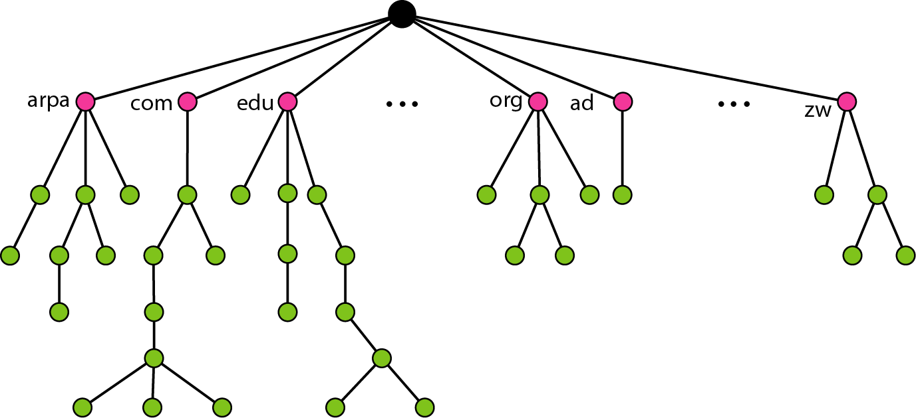

Slide 11
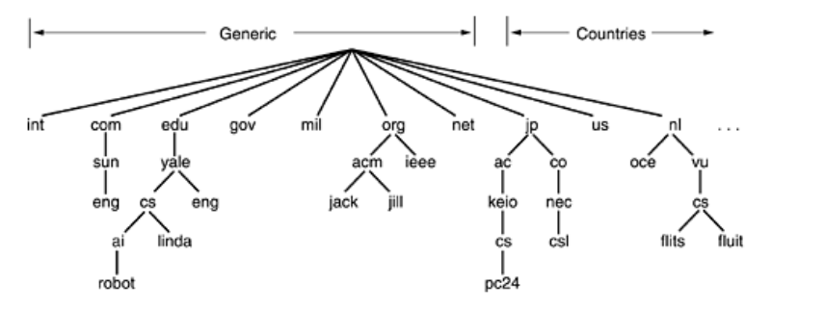
the Internet is divided into over 200 top-level domains, where each domain covers many hosts.

Slide 12
Domain Name Space
To have a hierarchical name space, a domain name space was designed.
In this design the names are defined in an inverted-tree structure with the root at the top.
The tree can have only 128 levels: level 0 (root) to level 127.

Slide 13
Label:
Each node in the tree has a label, which is a string with a maximum of 63 characters.
The root label is a null string (empty string).
DNS requires that children of a node have different labels, which guarantees the uniqueness of the domain names.
Domain Name:
Each node in the tree has a domain name.
A full domain name is a sequence of labels separated by dots (.).
The domain names are always read from the node up to the root.
The last label is the label of the root (null). This means that a full domain name always ends in a null label, which means the last character is a dot because the null string is nothing.

Slide 14
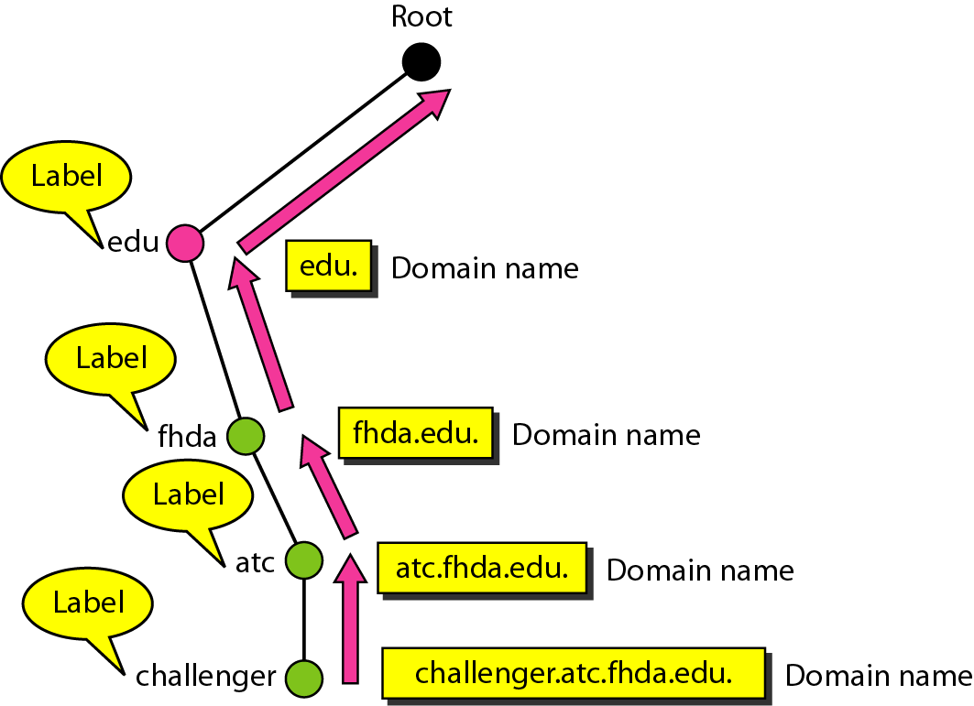

Slide 15
Fully Qualified Domain Name
If a label is terminated by a null string, it is called a fully qualified domain name (FQDN).
An FQDN is a domain name that contains the full name of a host.
It contains all labels, from the most specific to the most general, that uniquely define the name of the host.
For example, the domain name challenger.ate.tbda.edu.

Slide 16
Partially Qualified Domain Name
If a label is not terminated by a null string, it is called a partially qualified domain name (PQDN).
A PQDN starts from a node, but it does not reach the root.
It is used when the name to be resolved belongs to the same site as the client.
For example, if a user at the jhda.edu. site wants to get the IP address of the challenger computer, he or she can define the partial name challenger
The DNS client adds the suffix atc.jhda.edu. before passing the address to the DNS server.

Slide 17
RESOLUTION
Mapping a name to an address or an address to a name is called name-address resolution.
DNS is designed as a client/server application.
A host that needs to map an address to a name or a name to an address calls a DNS client called a resolver.
The resolver accesses the closest DNS server with a mapping request.
If the server has the information, it satisfies the resolver;
otherwise, it either refers the resolver to other servers or asks other servers to provide the information.
There are three methods of resolution:
Recursive
Iterative
Caching

Slide 18
Types of Resolution
Recursive Resolution
The client (resolver) can ask for a recursive answer from a name server. This means that the resolver expects the server to supply the final answer.
If the server is the authority for the domain name, it checks its database and responds.
If the server is not the authority, it sends the request to another server (the parent usually) and waits for the response.
If the parent is the authority, it responds;
otherwise, it sends the query to yet another server.
When the query is finally resolved, the response travels back until it finally reaches the requesting client.
This is called recursive resolution

Slide 19
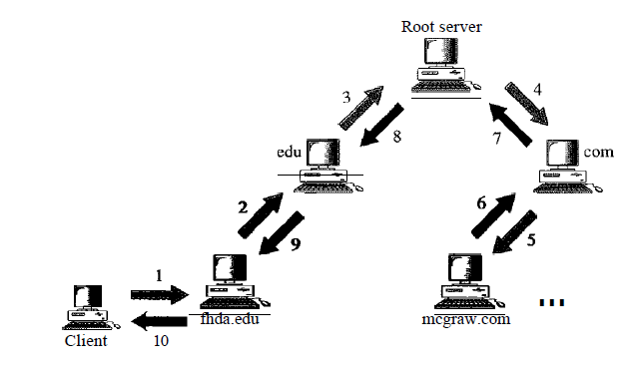
Recursive Resolution

Slide 20
Iterative Resolution
If the client does not ask for a recursive answer, the mapping can be done iteratively.
If the server is an authority for the name, it sends the answer. If it is not, it returns (to the client) the IP address of the server that it thinks can resolve the query.
The client is responsible for repeating the query to this second server. If the newly addressed server can resolve the problem, it answers the query with the IP address;
otherwise, it returns the IP address of a new server to the client.
Now the client must repeat the query to the third server.
This process is called iterative resolution because the client repeats the same query to multiple servers.

Slide 21
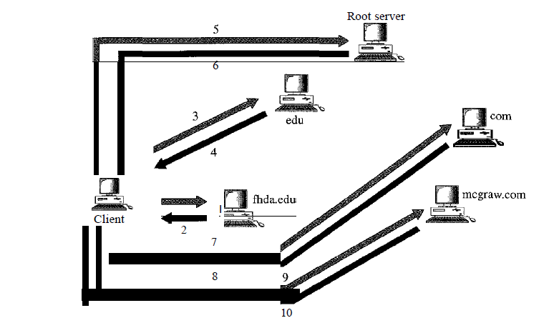
Iterative Resolution

Slide 22
CACHING
Each time a server receives a query for a name that is not in its domain, it needs to search its database for a server IP address.
Reduction of this search time would increase efficiency.
DNS handles this with a mechanism called caching.
When a server asks for a mapping from another server and receives the response, it stores this information in its cache memory before sending it to the client.
If the same or another client asks for the same mapping, it can check its cache memory and solve the problem.

Slide 23
REMOTE LOGGING
In the Internet, users may want to run application programs at a remote site and create results that can be transferred to their local site.
One way to satisfy that demand is to create a client/server application program such as (FTPs), e-mail (SMTP) for each desired service.
The better solution is a general-purpose client/server program that lets a user access any application program on a remote computer; in other words, allow the user to log on to a remote computer.
One of such a client/server application program is TELNET.

Slide 24
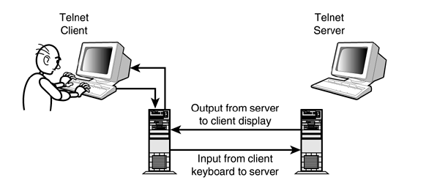
TELNET
TELNET is an abbreviation for TErminaL NETwork.

Slide 25
Characteristics of TELNET
Timesharing Environment
Logging
Local Logging
Remote Logging
Network Virtual Terminal
Embedding
Options

Slide 26
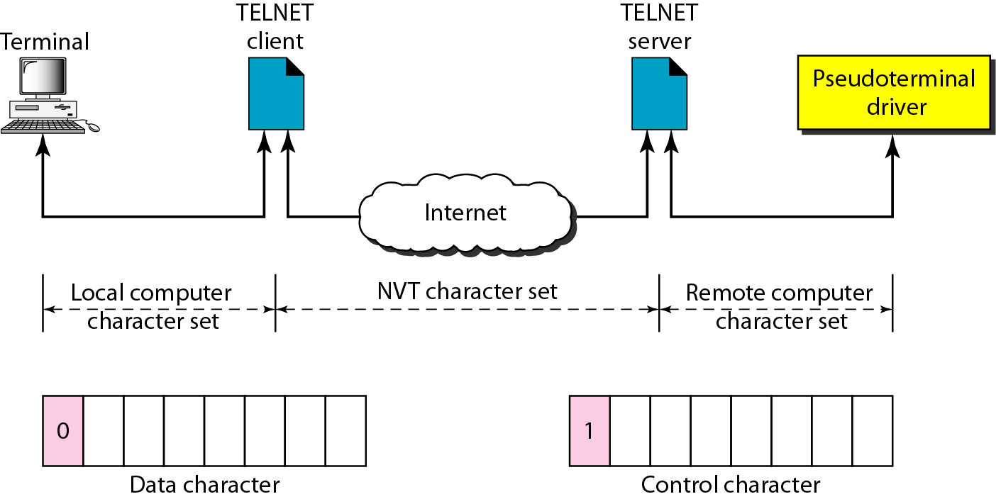
Network Virtual Terminal
We are dealing with heterogeneous systems.
If we want to access any remote computer in the world, we must first know what type of computer we will be connected to, and we must also install the specific terminal emulator used by that computer.
TELNET solves this problem by defining a universal interface called the network virtual terminal (NVT) character set. Via this interface, the client TELNET translates characters (data or commands) that come from the local terminal into NVT form and delivers them to the network.
The server TELNET, on the other hand, translates data and commands from NVT form into the form acceptable by the remote computer.

Slide 27
ELECTRONIC MAIL
One of the most popular Internet services is electronic mail (e-mail).
At the beginning of the Internet era, the messages sent by electronic mail were short and consisted of text only.
Today, electronic mail is much more complex. It allows a message to include text, audio, and video.
It also allows one message to be sent to one or more recipients.

Slide 28
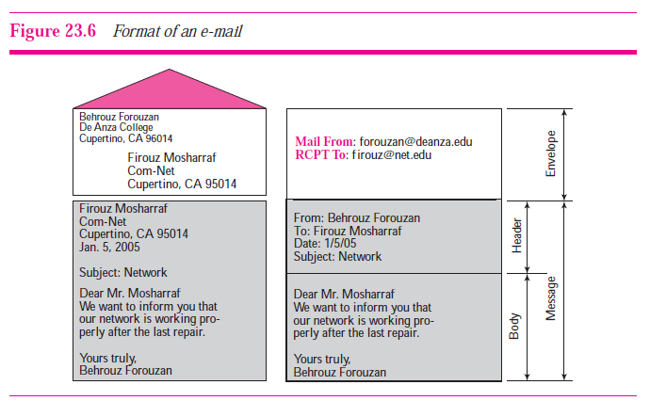
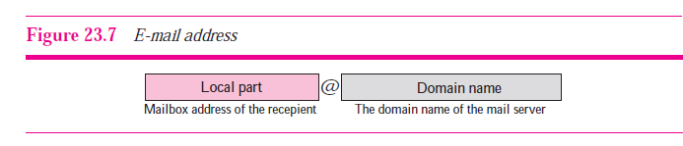

Slide 29
Components of e-mail
An e-mail system is based on the three main components:
User Agent (UA)
Message Transfer Agent (MTA)
Message Access Agent (MAA).

Slide 30
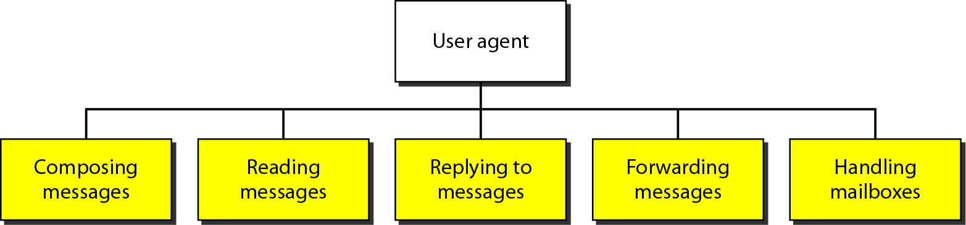
User Agents(UA)
The user agent (UA) provides services to the user to make the process of sending and receiving a message easier.
User agent is software (a software agent) that is acting on behalf of a user.
There are two types of user agents: command-driven and GUI-based.

Slide 31
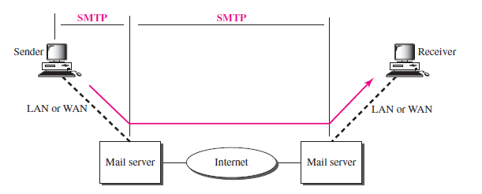
Message Transfer Agent (MTA): SMTP
The actual mail transfer is done through message transfer agents.
To send mail, a system must have the client MTA, and to receive mail, a system must have a server MTA.
The formal protocol that defines the MTA client and server in the Internet is called the Simple Mail Transfer Protocol (SMTP).

Slide 32
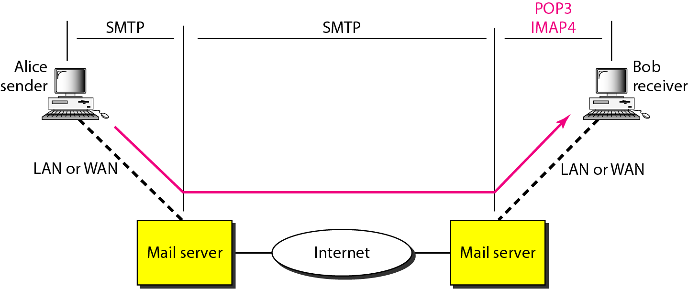
Message Access Agent (MAA)
SMTP is not involved in the third stage because SMTP is a push protocol; it pushes the message from the client to the server.
On the other hand, the third stage needs a pull protocol; the client must pull messages from the server
Currently two message access protocols are available: Post Office Protocol, version 3 (POP3) and Internet Mail Access Protocol, version 4 (IMAP4).

Slide 33
Architecture of e-mail
Architecture of e-mail can be described using four scenarios
We begin with the simplest situation and add complexity as we proceed.
The fourth scenario is the most common in the exchange of email.

Slide 34
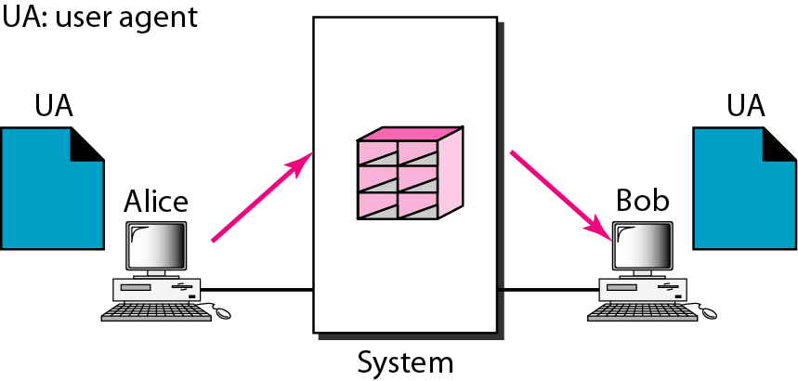
First Scenario:
When the sender and the receiver of an e-mail are on the same system, we need only two user agents. A mailbox is part of a local hard drive, a special file with permission restrictions. Only the owner of the mailbox has access to it.

Slide 35
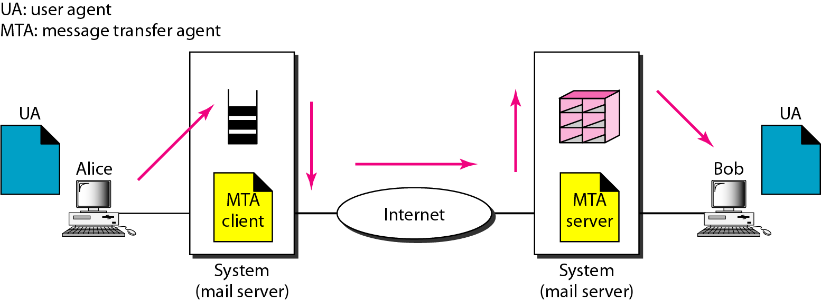
Second Scenario
When the sender and the receiver of an e-mail are on different systems, we need two UAs and a pair of MTAs (client and server).

Slide 36
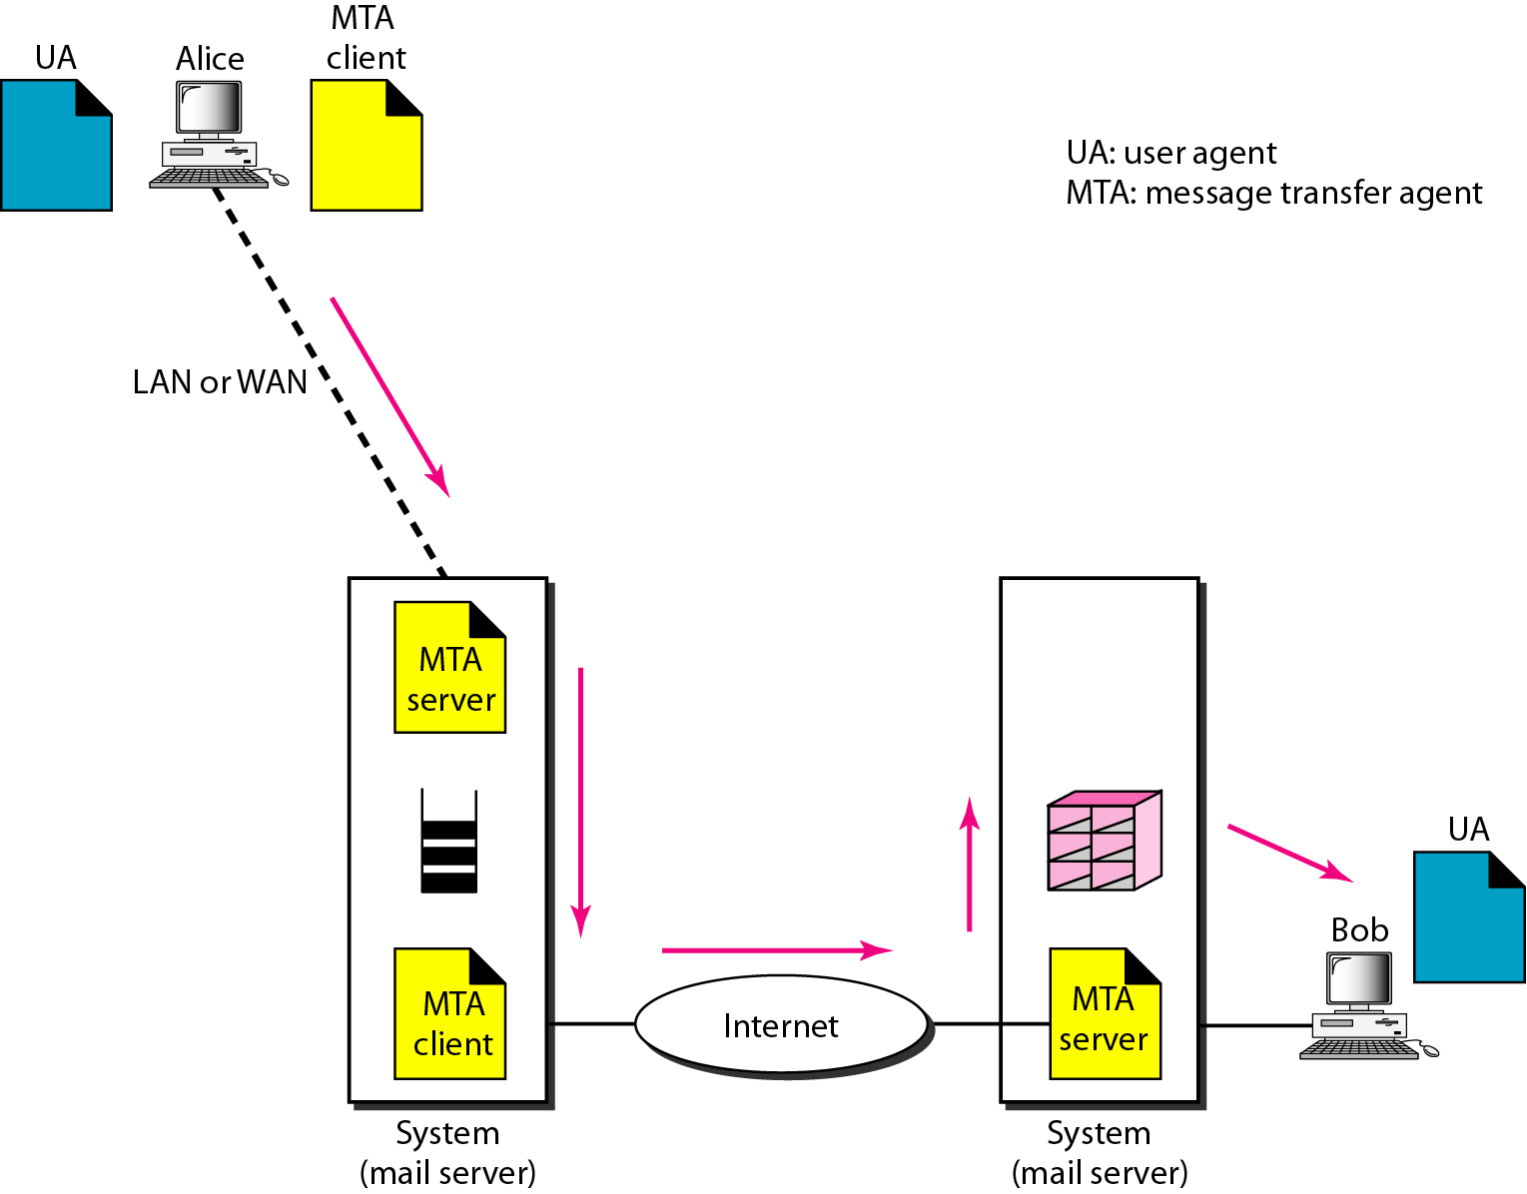
Third Scenario
When the sender is connected to the mail server via a LAN or a WAN, we need two UAs and two pairs of MTAs (client and server).

Slide 37
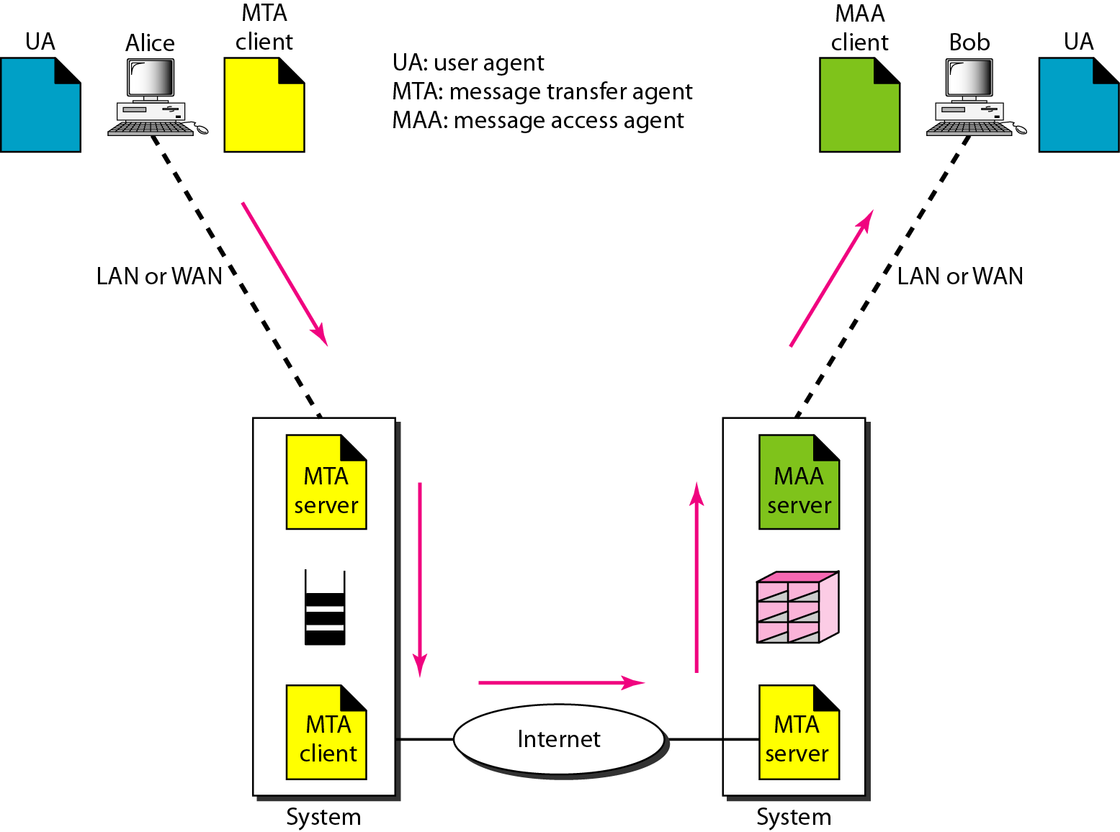
Fourth Scenario
When both sender and receiver are connected to the mail server via a LAN or a WAN, we need two UAs, two pairs of MTAs (client and server), and a pair of MAAs (client and server). This is the most common situation today.

Slide 38
File Transfer Protocol (FTP)
File Transfer Protocol (FTP) is the standard mechanism provided by TCP/IP for copying a file from one host to another.
FTP differs from other client/server applications in that it establishes two connections between the hosts.
One connection is used for data transfer,
the other for control information (commands and responses).
FTP uses two well-known TCP ports:
Port 21 is used for the control connection, and
port 20 is used for the data connection.

Slide 39
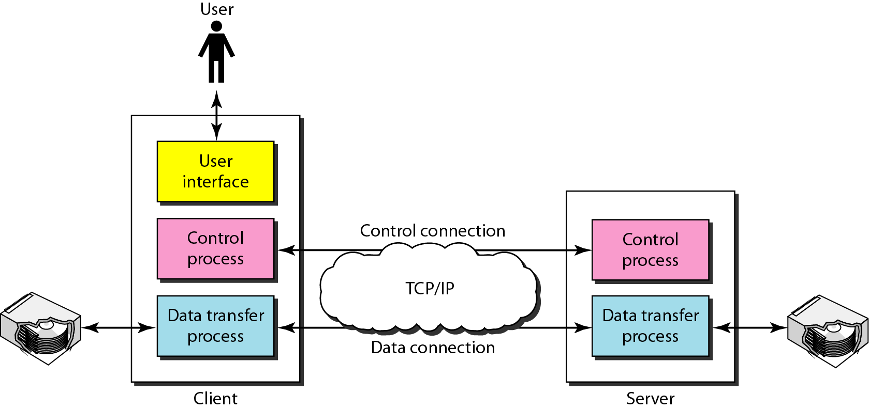
The client has three components:
user interface
client control process
client data transfer process
The server has two components:
server control process
server data transfer process
The control connection is made between the control processes.
The data connection is made between the data transfer processes.

Slide 40
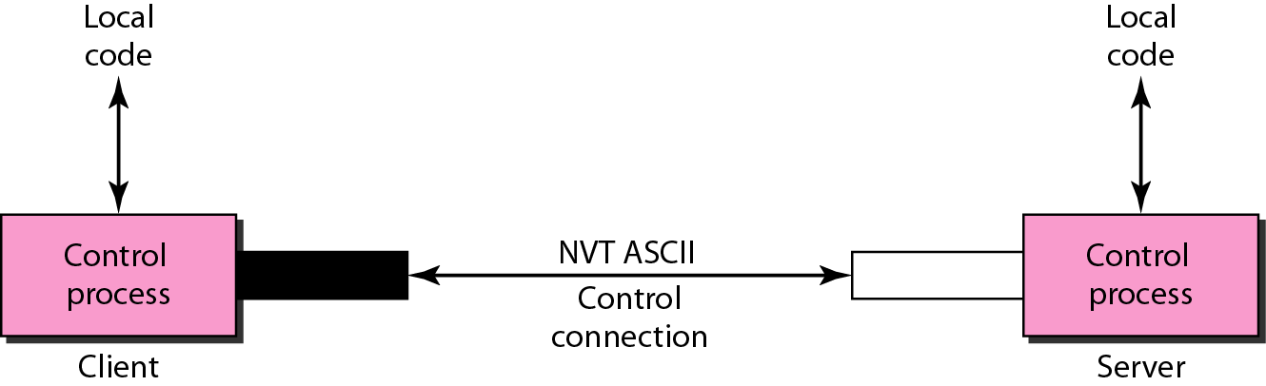
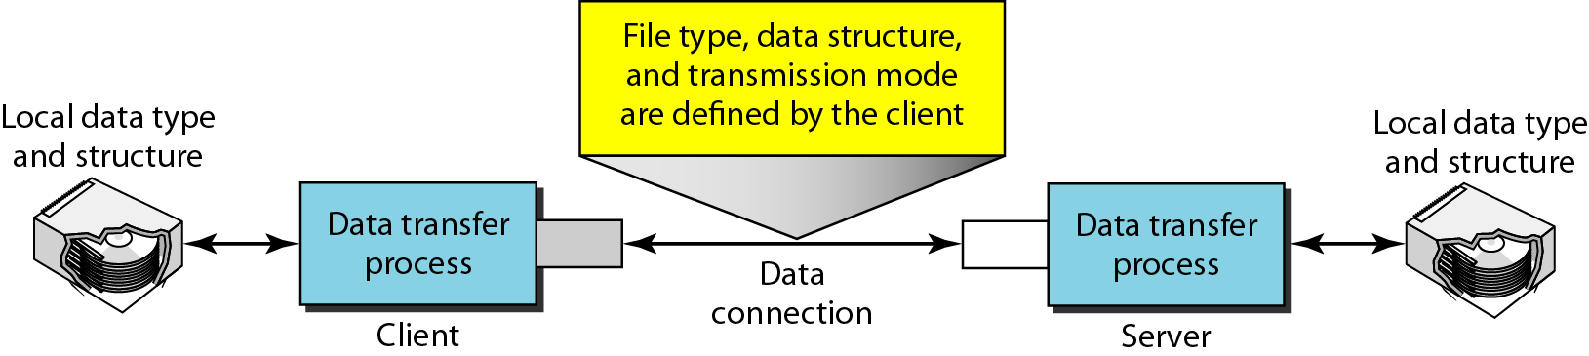
FTP uses the services of TCP. It needs two TCP connections.
The well-known port 21 is used for the control connection
The well-known port 20 is used for the data connection.
Using the control connection
Using the data connection

Slide 41
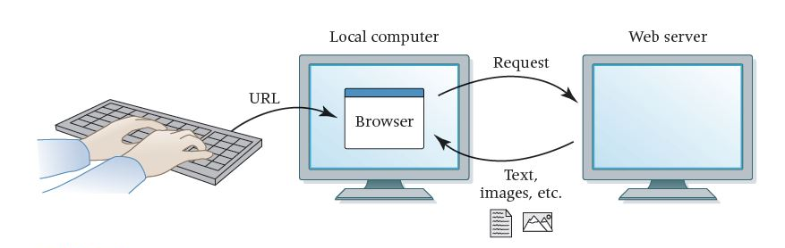
World Wide Web (www)
The World Wide Web (WWW) is a repository of information linked together from points all over the world.
The WWW has a unique combination of flexibility, portability, and user-friendly features that distinguish it from other services provided by the Internet.

Slide 42
Website: A collection of related web pages
Web browser: A software tool that retrieves and displays web pages
Web server: A computer set up to respond to requests for web pages
Uniform Resource Locator (URL): A standard way of specifying the location of a Web page, containing the hostname, "/", and a file

Slide 43
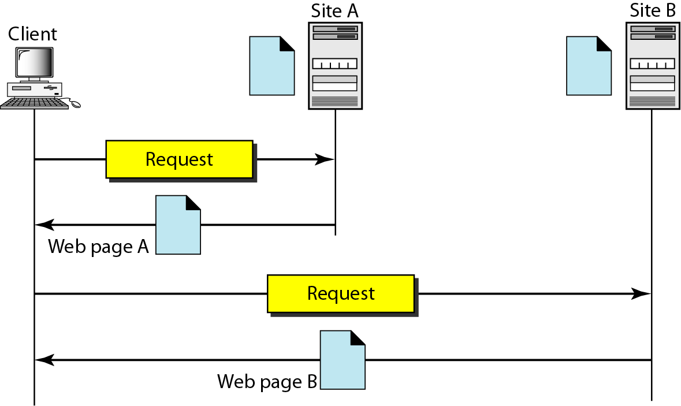
Architecture of WWW
The WWW today is a distributed client/server service, in which a client using a browser can access a service using a server.
The service provided is distributed over many locations called sites

Slide 44
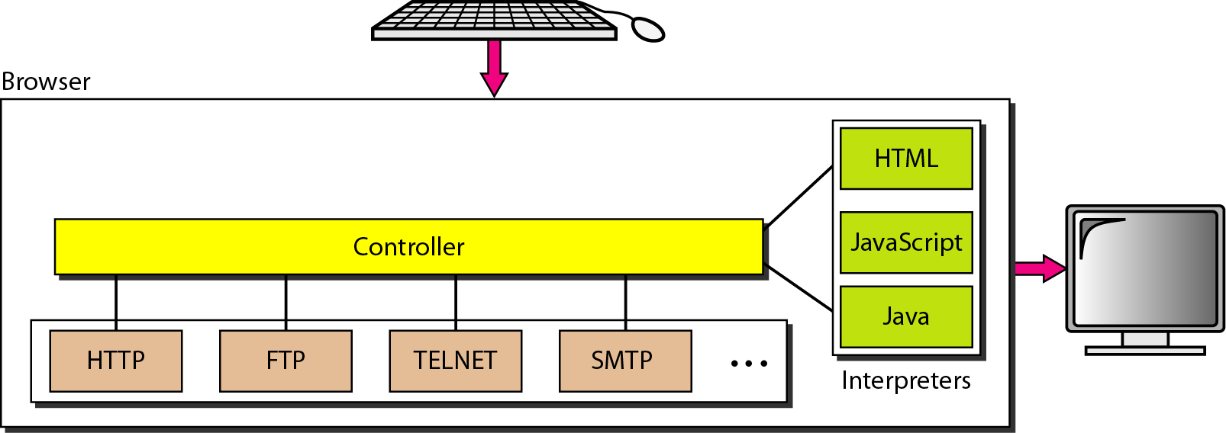
Client (Browser)
Each browser usually consists of three parts:
a controller,
client protocol, and
interpreters
The controller receives input from the keyboard or the mouse and uses the client protocols to access the document.
After the document has been accessed, the controller uses one of the interpreters to display the document on the screen.

Slide 45
Server
The Web page is stored at the server. Each time a client request arrives, the corresponding document is sent to the client.
To improve efficiency, servers normally store requested files in a cache in memory; memory is faster to access than disk.
A server can also become more efficient through multithreading or multiprocessing. In this case, a server can answer more than one request at a time.
Uniform Resource Locator
A URL is defined as any character string that identifies a resource
The URL defines four things: protocol, host computer, port, and path
https://meet.google.com/tsv-qyux-ppi

Slide 46
The protocol is the client/server program used to retrieve the document.
Many different protocols can retrieve a document; among them are FTP or HTTP. The most common today is HTTP.
The host is the computer on which the information is located.
Web pages are usually stored in computers, and computers are given alias names that usually begin with the characters "www". This is not mandatory.
The URL can optionally contain the port number of the server.
If the port is included, it is inserted between the host and the path, and it is separated from the host by a colon.
Path is the pathname of the file where the information is located.

Slide 47
Hypertext Transfer Protocol (HTTP)
The Hypertext Transfer Protocol (HTTP) is a protocol used mainly to access data on the World Wide Web. HTTP functions as a combination of FTP and SMTP.
HTTP uses the services of TCP on well-known port 80.
It is similar to FTP because it transfers files and uses the services of TCP.
Unlike FTP there is no separate control connection; only data are transferred between the client and the server.

Slide 48
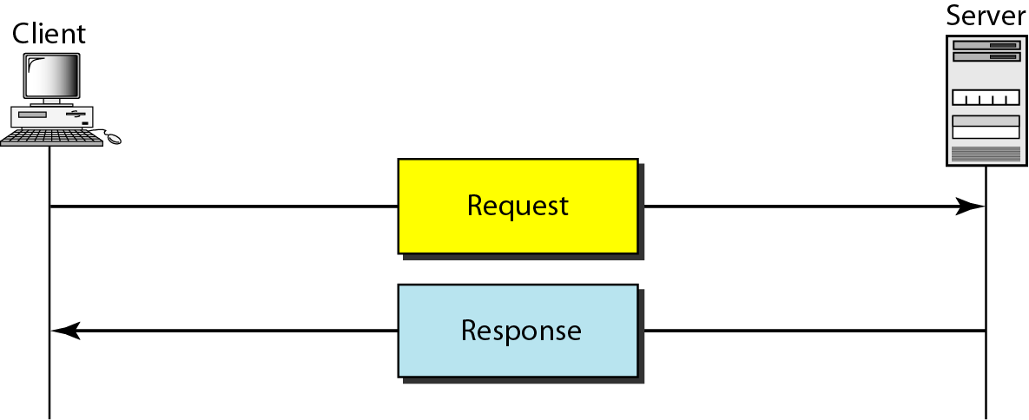
HTTP Transaction
HTTP uses the services of TCP, however HTTP itself is a stateless protocol.
The client initializes the transaction by sending a request message.
The server replies by sending a response message.

Slide 49
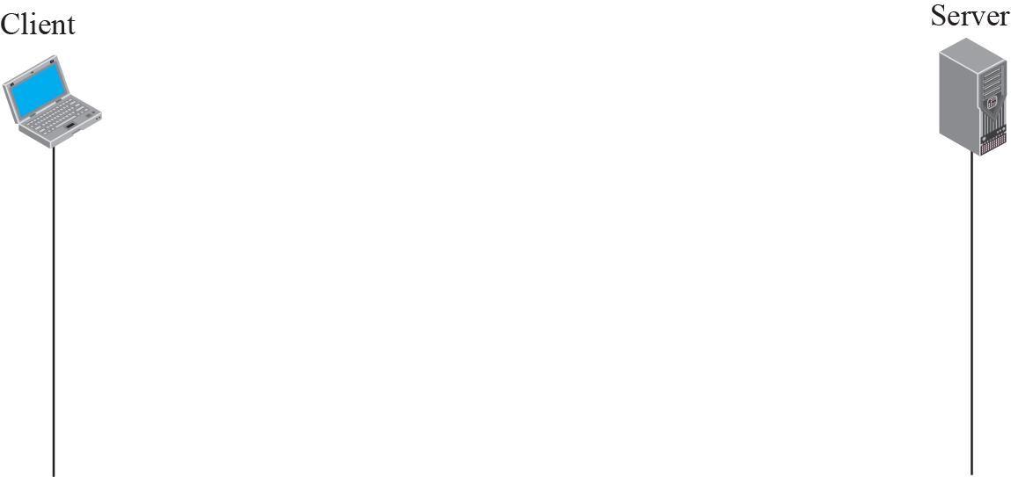
Messages in HTTP
A request message consists of a request line, a header, and sometimes a body.
A response message consists of a status line, a header, and sometimes a body.

Slide 50
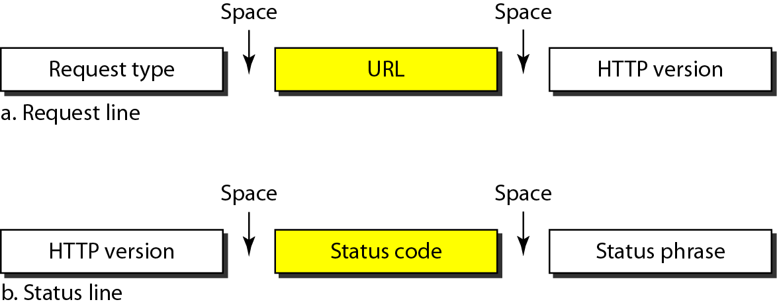
Request and Status Lines:
The first line in a request message is called a request line.
The first line in the response message is called the status line.

Slide 51
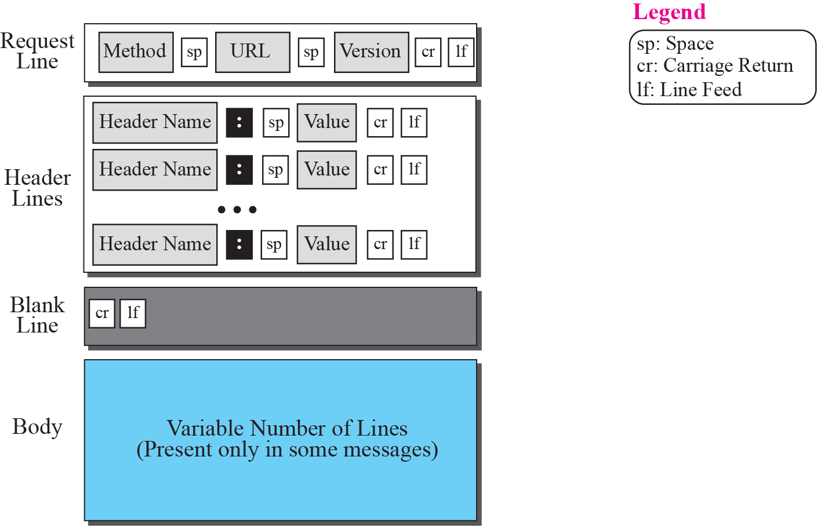
Format of the request message

Slide 52
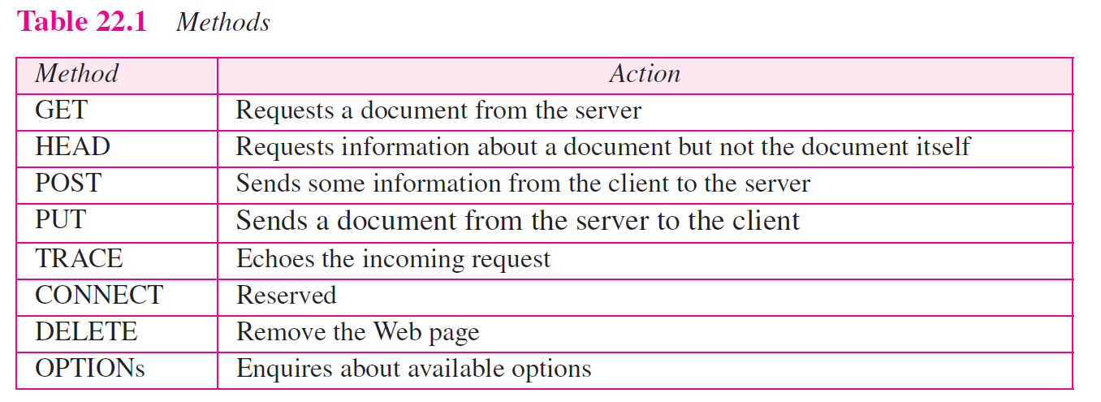

Slide 53
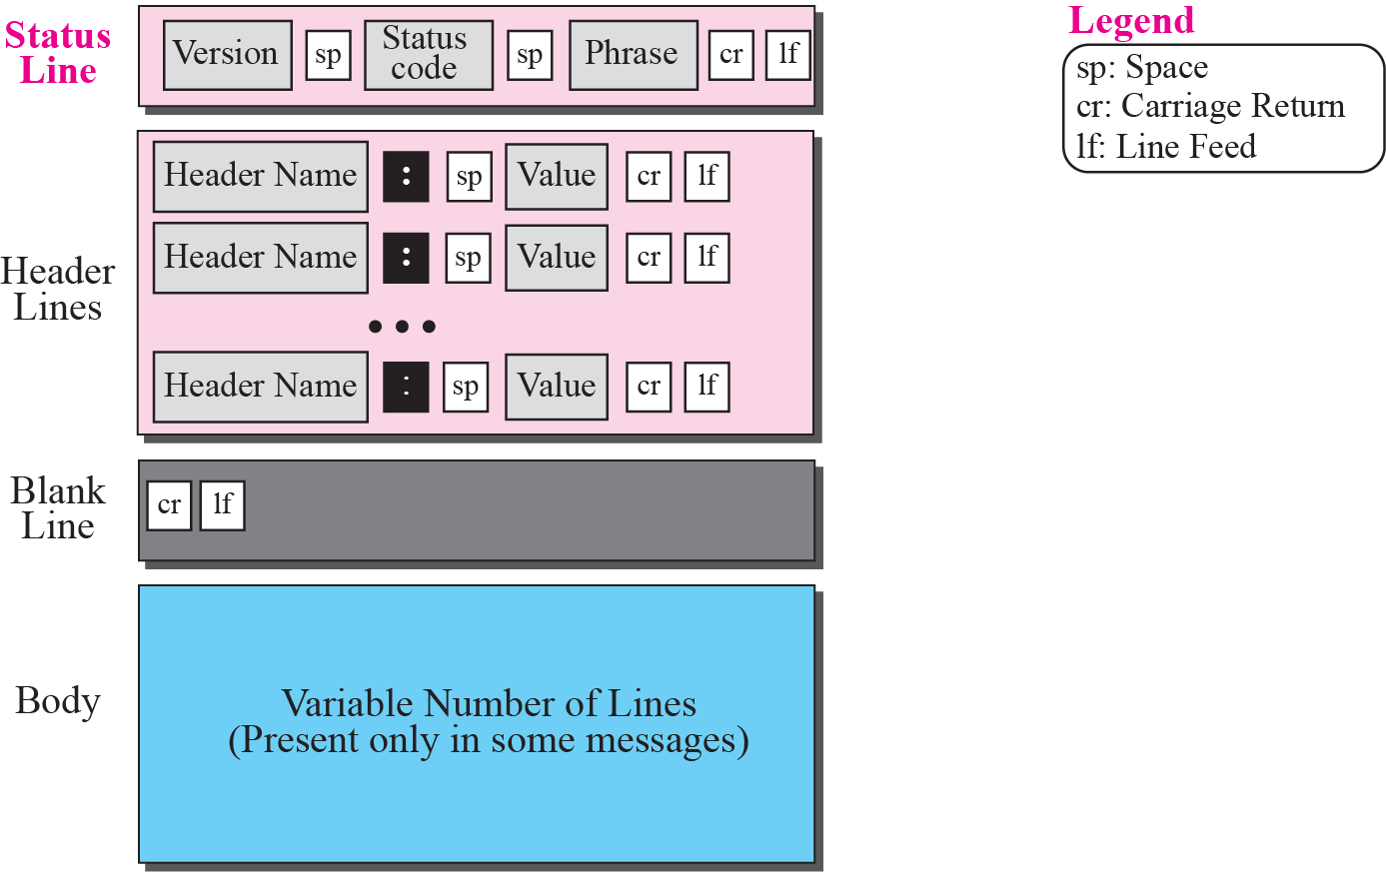
Format of the response message

Slide 54
Network Management: SNMP
Network management can be defined as monitoring, testing, configuring, and troubleshooting network components to meet a set of requirements defined by an organization.
These requirements include the smooth, efficient operation of the network that provides the predefined quality of service for users.
To accomplish this task, a network management system uses hardware, software, and humans.

Slide 55
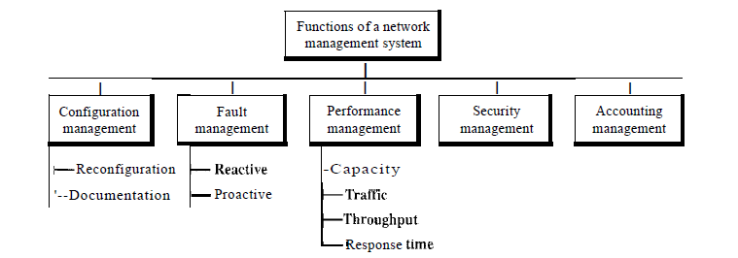
Functions of Network Management
The functions performed by a network management system can be divided into five broad categories:
Configuration management
Fault management
Performance management
Security management
Accounting management

Slide 56
Network Security
Security is one of the important aspects in data communications and networking.
Security in networking is based on cryptography, the science and art of transforming messages to make them secure and immune to attack.
Cryptography can provide several aspects of security related to the interchange of messages through networks.
These aspects are
confidentiality,
integrity,
authentication, and
nonrepudiation.

Slide 57
Message Confidentiality: Message confidentiality or privacy means that the sender and the receiver expect confidentiality. The transmitted message must make sense to only the intended receiver. To all others, the message must be garbage.
Message Integrity: Message integrity means that the data must arrive at the receiver exactly as they were sent. There must be no changes during the transmission, neither accidentally nor maliciously.
Message Authentication: In message authentication the receiver needs to be sure of the sender's identity and that an imposter has not sent the message.
Message Nonrepudiation: Message nonrepudiation means that a sender must not be able to deny sending a message that he or she, in fact, did send.
Entity Authentication: In entity authentication (or user identification) the entity or user is verified prior to access to the system resources (files, for example).

Slide 58
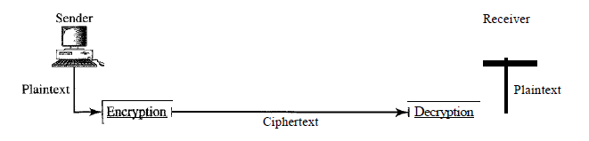
Cryptography
Cryptography, a word with Greek origins, means "secret writing."
However, we use the term to refer to the science and art of transforming messages to make them secure and immune to attacks.

Slide 59
Some Basic Terminology
plaintext - original message
ciphertext - coded message
key - info used in cipher known only to sender/receiver
encipher (encrypt) - converting plaintext to ciphertext
decipher (decrypt) - recovering plaintext from ciphertext
cryptography - study of encryption principles/methods
cryptanalysis (codebreaking) - study of principles/ methods of deciphering ciphertext without knowing key
cryptology - field of both cryptography and cryptanalysis

Slide 60
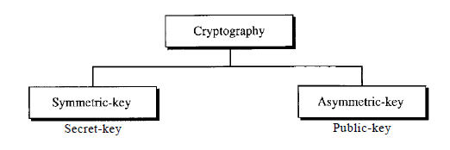
Categories of Ciphers
All the cryptography algorithms (ciphers) divided into two groups:

Slide 61
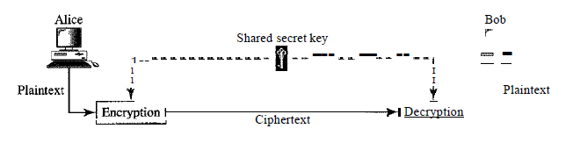
Symmetric key (also called secret-key) Ciphers:
In symmetric-key cryptography, the same key is used by both parties. The sender uses this key and an encryption algorithm to encrypt data; the receiver uses the same key and the corresponding decryption algorithm to decrypt the data

Slide 62
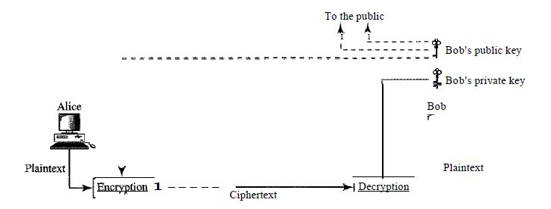
Asymmetric key (also called public-key) Ciphers:
In asymmetric or public-key cryptography, there are two keys: a private key and a public key. The private key is kept by the receiver. The public key is announced to the public.

Slide 63
Internet Security
IPSec protocol
Virtual Private Network (VPN)
Firewalls

Slide 64
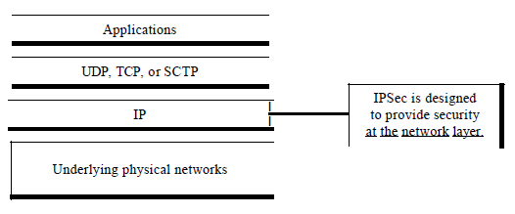
IPSec Protocol
IPSecurity (IPSec) is a collection of protocols designed by the Internet Engineering Task Force (IETF) to provide security for a packet at the network level.
IPSec helps to create authenticated and confidential packets for the IP layer

Slide 65
Transport and Tunnel Mode
Another important concept reused:
Transport mode: Protection of packet payload
Tunnel mode: Protection of entire packet
Transport mode used in end to end communication between hosts.
ESP: encrypts (+ authenticate) payload, not header
AH: Authenticates payload, selected header bits
Tunnel mode: new routing info added
ESP: encrypts (+ authenticate) packet (not outer header)
AH: authenticates entire packet, selected outer bits.

Slide 66
Virtual Private Networks
Organizations requires privacy in both intra and inter organization communication.
Privacy can be achieved in the internal communications of an organisation by using one of the three strategies:
Private networks
Hybrid networks
Virtual private networks

Slide 67
Intranet: An intranet is a private network (LAN) that uses the Internet model. However, access to the network is limited to the users inside the organization. The network uses application programs defined for the global Internet, such as HTTP, and may have Web servers, print servers, file servers, and so on.
Extranet: An extranet is the same as an intranet with one major difference: Some resources may be accessed by specific groups of users outside the organization under the control of the network administrator.

Slide 68
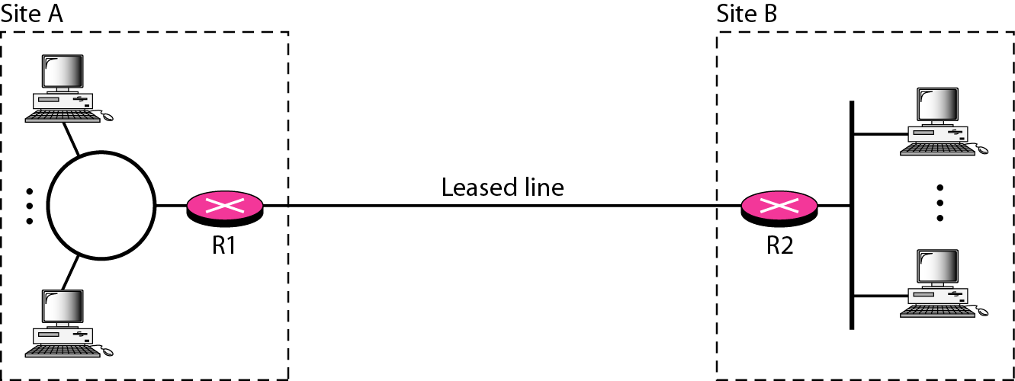
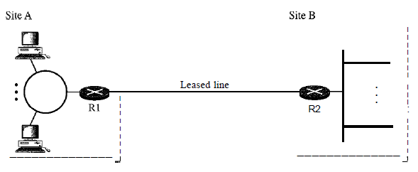
Private Networks
A small organization with one single site can use an isolated LAN.
People inside the organization can send data to one another that totally remain inside the organization, secure from outsiders.
A larger organization with several sites can create a private internet.
The LANs at different sites can be connected to each other by using routers and leased lines. In other words, an internet can be made out of private LANs and private WANs.
These private networks are totally isolated from the global internet.

Slide 69
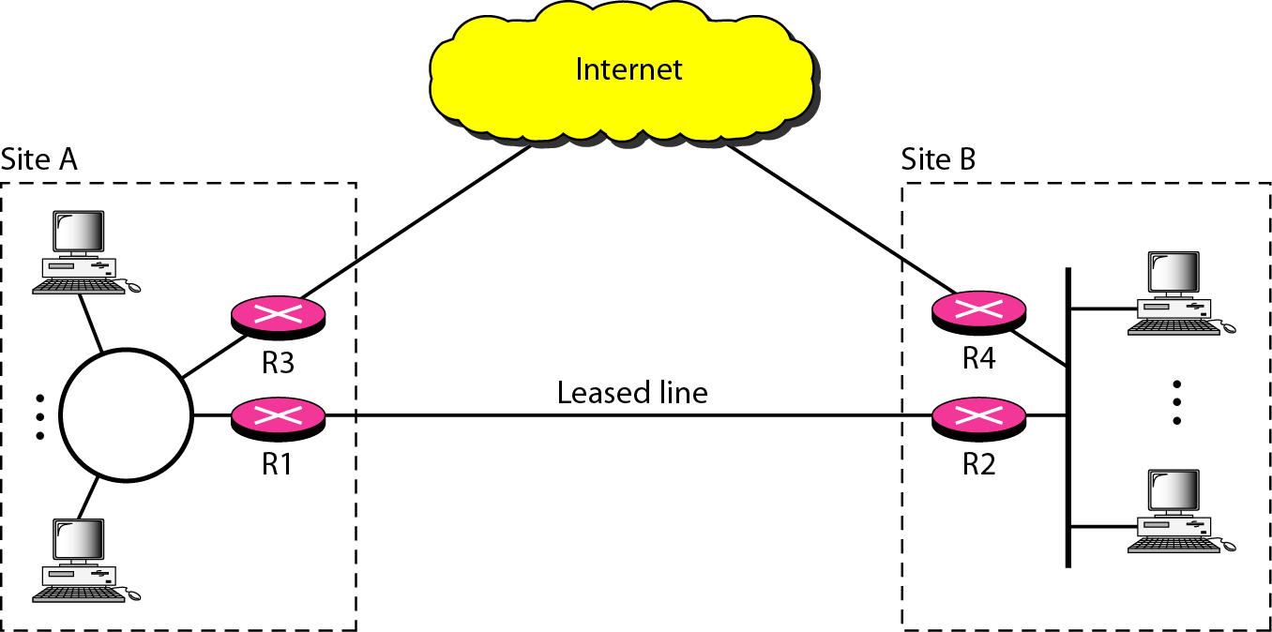
Hybrid Networks
A hybrid network allows an organization to have its own private internet and, at the same time, access to the global Internet. Intraorganization data are routed through the private internet; interorganization data are routed through the global Internet.

Slide 70
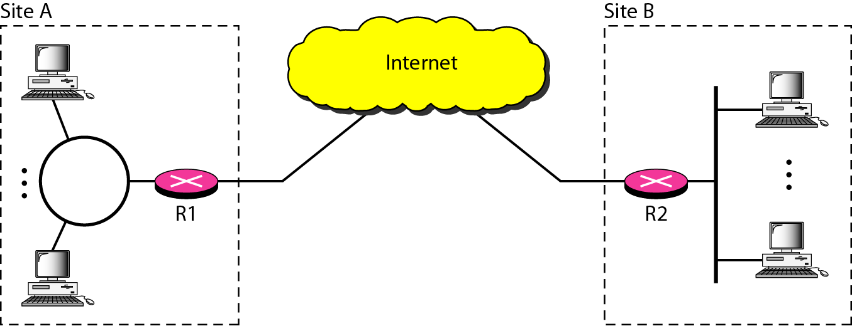
Virtual Private Networks
Virtual private network allows organizations to use the global Internet for both purposes.
VPN creates a network that is private but virtual.
It is private because it guarantees privacy inside the organization.
It is virtual because it does not use real private WANs; the network is physically public but virtually private.

Slide 71
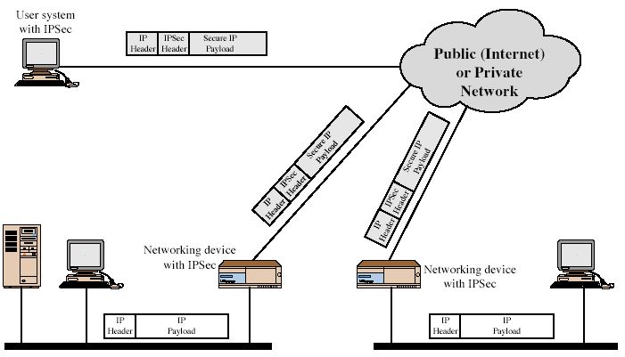
Virtual Private Network Technology

Slide 72
VPN technology uses IPSec in the tunnel mode to provide authentication, integrity, and privacy.
Tunneling guarantee privacy and other security measures for an organization,
VPN can use the IPSec in the tunnel mode. In this mode, each IP datagram destined for private use in the organization is encapsulated in another datagram.
To use IPSec in tunneling, the VPNs need to use two sets of addressing:
Private Addresses
Public Addresses

Slide 73
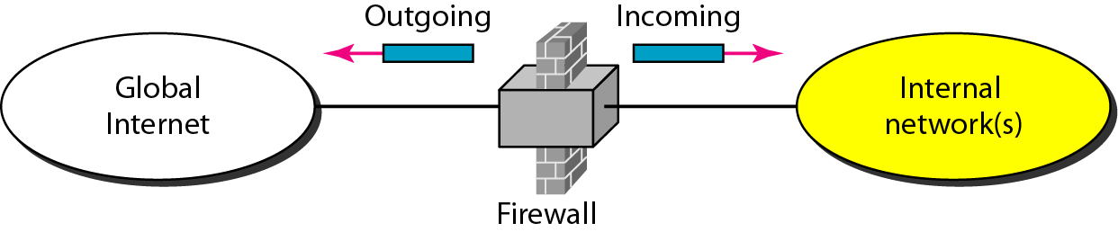
Firewalls
A firewall is a device installed between the internal network of an organization and the rest of the Internet.
It is designed to forward some packets and filter (block) others.
A firewall is usually classified as:
packet-filter firewall
proxy-based firewall.

Slide 74
Packet Filter Firewalls
A firewall can be used as a packet filter to forward or block packets based on the information in the:
network layer headers
transport layer headers
Network Layer
source and destination IP addresses,
Transport Layer
source and destination port addresses
Type of protocol TCP or UDP

Slide 75
A packet-filter firewall filters packets at the network or transport layer.

Slide 76
Proxy Firewalls
Sometimes we need to filter a message based on the information available in the message itself.
For example, assume that an organization wants to implement the following policies regarding its Web pages:
Only those Internet users who have previously established business relations with the company can have access; access to other users must be blocked.
In this case, a packet-filter firewall is not feasible because it cannot distinguish between different packets arriving at TCP port 80 (HTTP). Testing must be done at the application level (using URLs).

Slide 77
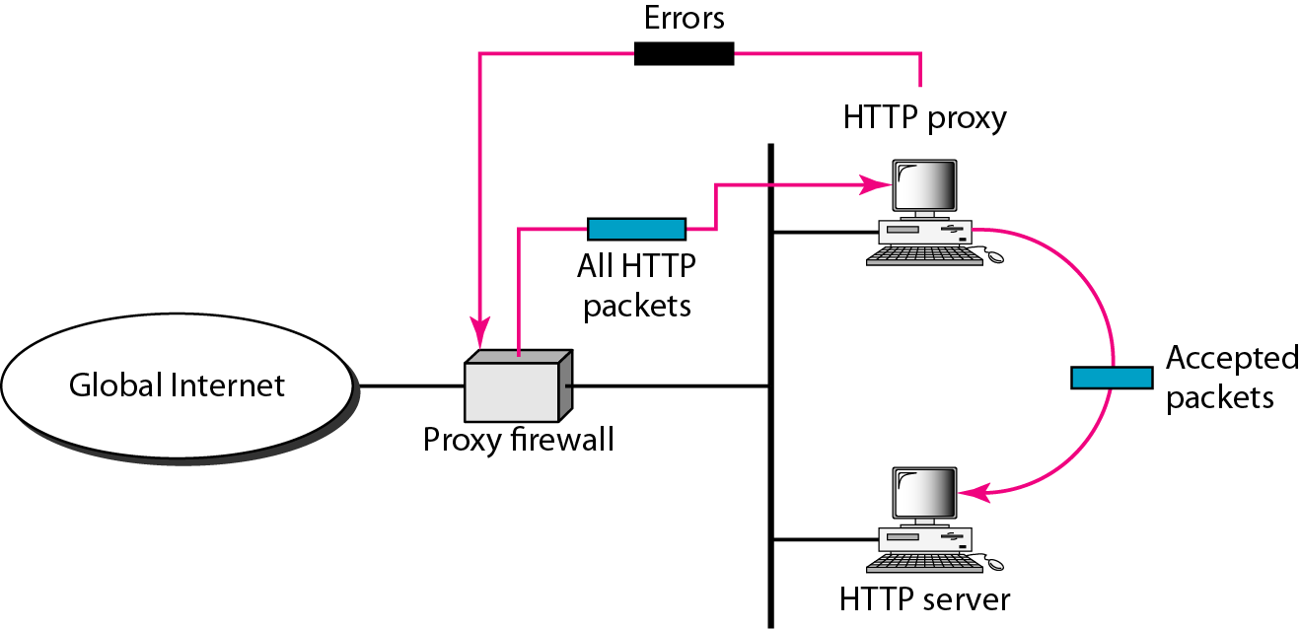
When the user client process sends a message, the proxy firewall runs a server process to receive the request.
The server opens the packet at the application level and finds out if the request is legitimate.
If it is legitimate, the server acts as a client process and sends the message to the real server.
If it is not legitimate, the message is dropped and an error message is sent to the external user.

Slide 78
A proxy firewall filters at the application layer.

